Slide 1


MUSIC POPULARITY PREDICTOR
Predictive Modelling using Ridge Regression

Slide 2


INTRODUCTION
In today’s music industry, streaming platforms generate massive amounts of data about songs and listener preferences.
Predicting a song’s popularity helps artists, producers, and streaming services make data-driven decisions.
This project focuses on predicting the popularity of songs using various audio features provided by Spotify.
By analyzing audio characteristics like tempo, valence, danceability, and more, we aim to understand what makes a song popular and build a predictive model.

Slide 3



OBJECTIVE
Goal :
Analyze Spotify song features dataset
Build a regression model to predict target feature(s)
Approach :
Data exploration
Preprocessing
Ridge regression with hyperparameter tuning

Slide 4

WHICH DATASET???
Dataset Name: SpotifyFeatures.csv
Features:
Includes numerical and categorical song features
Quick stats shown using df.describe(), df.info(), df.shape(), etc.

Slide 5

TOOLS AND TECHNOLOGIES

Slide 6
Libraries Used :
pandas, numpy (data manipulation)
matplotlib, seaborn (visualisation)
scikit-learn (preprocessing, modelling, evaluation)
Checked :
Shape, size, info, head, describe
Techniques Used for Data Preprocessing :
StandardScaler for numerical features
OneHotEncoder for categorical features
Combined using ColumnTransformer

Slide 7
Model Used : Ridge Regression
Why Ridge?
Regularisation to prevent overfitting
L2 penalty term
Hyperparameter Tuning
Method : GridSearchCV
Purpose : Optimal alpha value selection for Ridge regression
Process : Cross-validation on different alpha values
Combined preprocessing and model into a single pipeline using Pipeline for efficient training and prediction.
Metrics Used for Model Evaluation :
Mean Squared Error (MSE)
R² Score (Coefficient of Determination)

Slide 8
AND RESULTS???
Finally, we got the following evaluation metrics for the model trained on our test data using Ridge Regression :
RMSE : 9.018948133091445
R2 Score : 0.773757365034048
More effectiveness of Ridge Regression for dataset in comparison to RandomForest and other methods, as the model results lower RMSE score and higher R2 Score for the dataset than any other model.

Slide 9
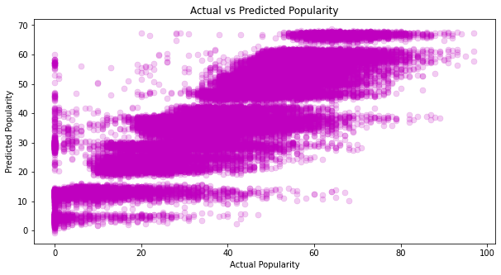
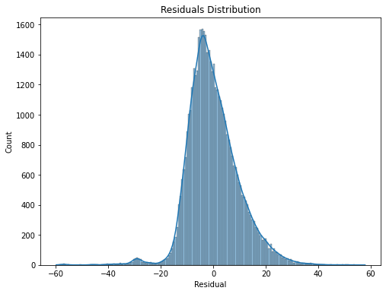

Slide 10
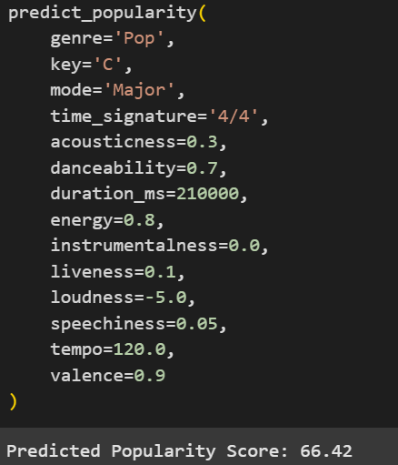
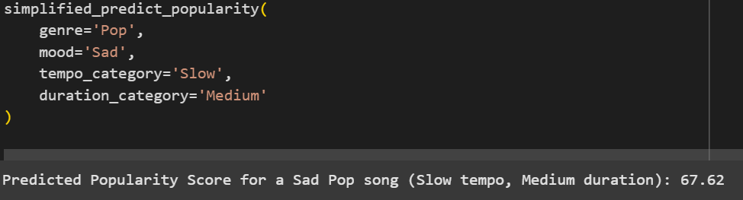
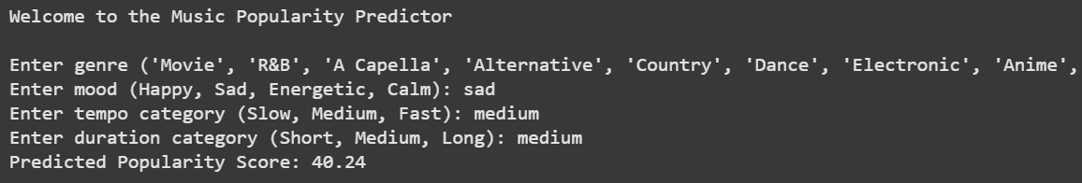

Slide 11

THANK YOU
FOR PLAYING!

